Slide 1

CS302 Design and Analysis of Algorithms
Muhammad sohail afzal

Slide 2
Matrix Chain Multiplication : Some important concepts
A x B = D
(10x100) (100 x 5) (10x5)
Multiplication is only possible when :
(Column of first matrix = Rows of second matrix)
For example : multiplication of A and B is possible as 100=100

Slide 3
Matrix Chain Multiplication : Some important concepts
A x B = D
(10x100) (100 x 5) (10x5)
Matrix that will come after multiplication of two matrices will have order :
(Rows of first matrix) x (Columns of second matrix)
For example : if D = A x B then order of D would be (10 x 5)

Slide 4
Matrix Chain Multiplication : Some important concepts
A x B = D
(10x100) (100 x 5) (10x5)
Number of multiplication operations performed while multiplying two matrices :
(No. of Rows of first matrix) x (No. of columns of first matrix) x (No. of Column of second matrix)
OR
(No. of Rows of first matrix) x (No. of rows of second matrix) x (No. of Column of second matrix)
For example: No. of multiplication operations when A and B are multiplied = 10 x 100 x 5 = 5000 operations

Slide 5
Matrix Chain Multiplication : Some important concepts
Suppose we have 4 matrices A, B, C and D. We want to find total number of multiplication operations performed when these 4 matrices are multiplied In order ((AB) (CD))
Then
First we need to find total number of multiplication operations in A x B (suppose A x B gives J matrix)
Then we need to find total number of multiplication operations in C x D (suppose C x D gives K matrix)
Then we need to find total number of multiplication operations in J x K
At the end, we need to add all the three to get total number of multiplication operations. See example on next slide

Slide 6
Matrix Chain Multiplication : Some important concepts
Suppose A is (2 x 5) , B is (5 x 3) , C is (3 x 8) , D is (8 x 2)
We need to find total number of multiplication operations involved in ((AB)(CD))
Then
First we need to find total number of multiplication operations in A x B (suppose A x B gives J matrix that will have order 2x3) [2 x 5 x 3 = 30 operations]
Then we need to find total number of multiplication operations in C x D (suppose C x D gives K matrix that will have order 3x2) [3 x 8 x 2 = 48 operations]
Then we need to find number of multiplication operations in J x K [2 x 3 x 2 = 12 operations]
Now we need to add all three = 30 + 48 + 12 = 90 total multiplication operations

Slide 7
Matrix Chain Multiplication : Some important concepts
Suppose we have four matrices in chain :
A = { A(1), A(2), A(3), A(4) } starts from index 1
And their dimensions are : starts from index 0
P = { 2, 3, 5, 6, 3 }
Then it means that :
Dimension of A(1) = 2x3
Dimension of A(2) = 3x5
Dimension of A(3) = 5x6
Dimension of A(4) = 6x3
Which can also be written as : dimension of A(i) = P(i-1) x P(i)

Slide 8
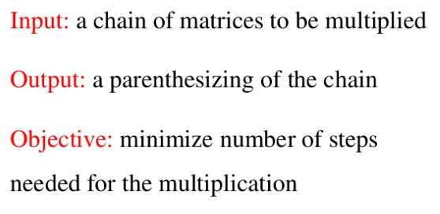
Matrix chain multiplication
Now here comes problem of matrix chain multiplication where we have chain of matrices to be multiplied where we don’t know multiplication in which order will give less number of multiplication operations. Parenthesis shows the order in which matrices should be multiplied

Slide 9
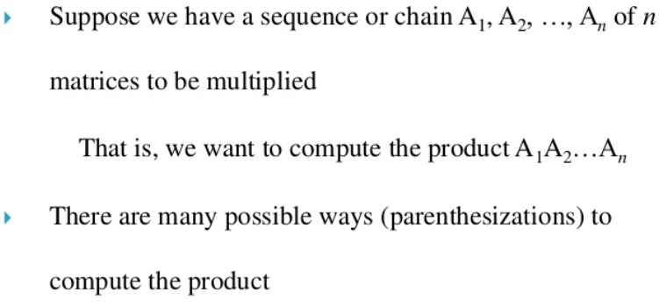
Matrix chain multiplication

Slide 10
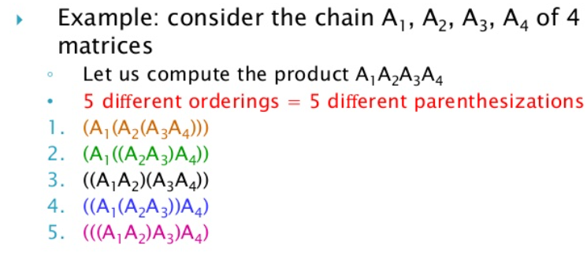
Matrix chain multiplication

Slide 11
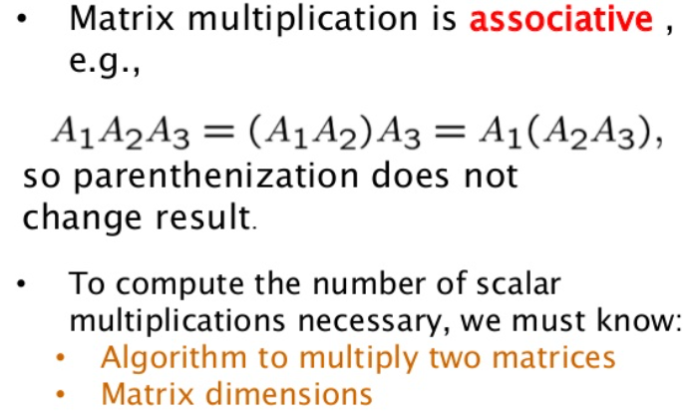
Matrix chain multiplication

Slide 12
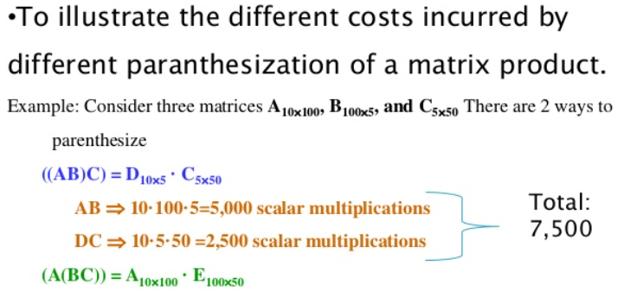

Matrix chain multiplication

Slide 13
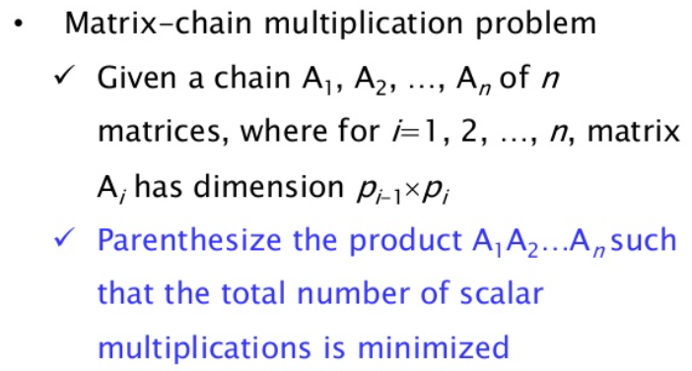
Matrix chain multiplication

Slide 14
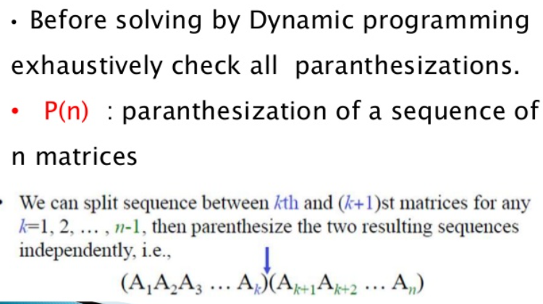
Matrix chain multiplication: Brute Force

Slide 15
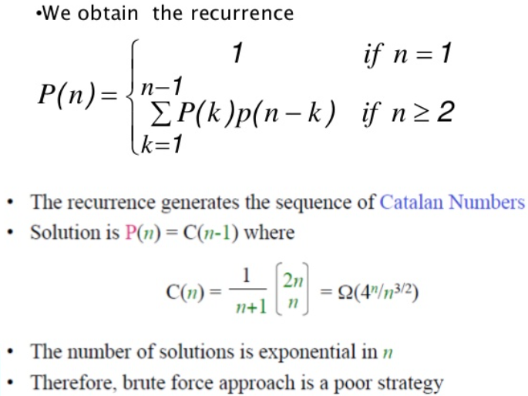
Matrix chain multiplication: Brute Force

Slide 16
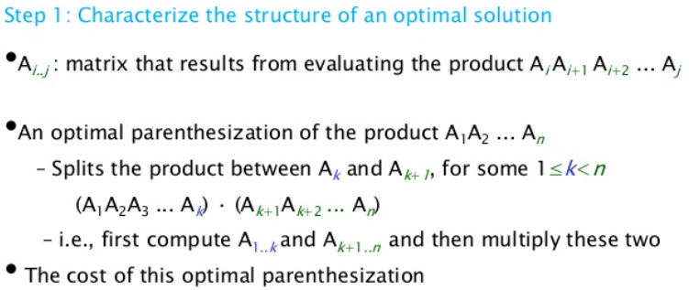
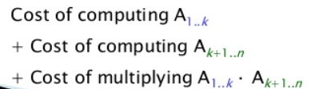
Matrix chain multiplication: Dynamic Programming

Slide 17
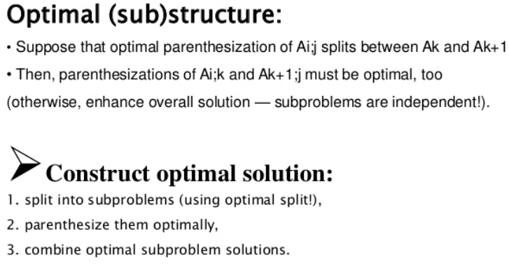
Matrix chain multiplication: Dynamic Programming

Slide 18
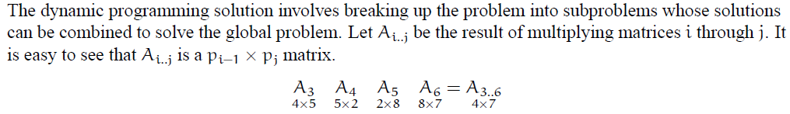
Matrix chain multiplication: Dynamic Programming
Chain of matrices = A = { A3,A4,A5,A6 } ; index starts from 1
Dimensions of matrices = P = { 4,5,2,8,7} ; index starts from 0

Slide 19
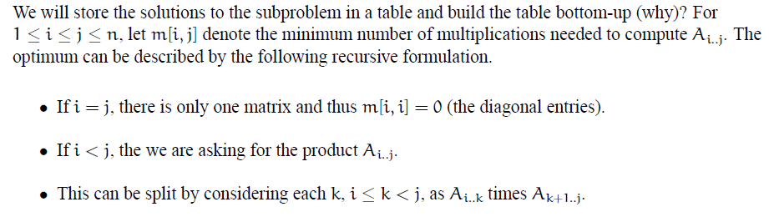
Matrix chain multiplication: Dynamic Programming

Slide 20
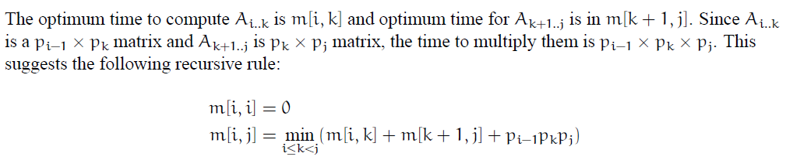
Matrix chain multiplication: Dynamic Programming

Slide 21
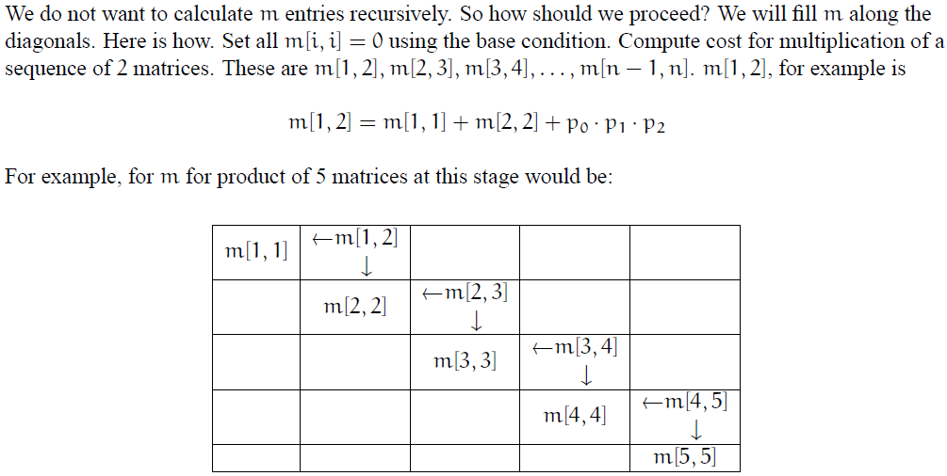
Matrix chain multiplication: Dynamic Programming

Slide 22
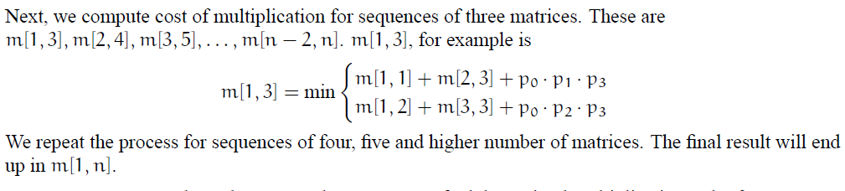
Matrix chain multiplication: Dynamic Programming

Slide 23
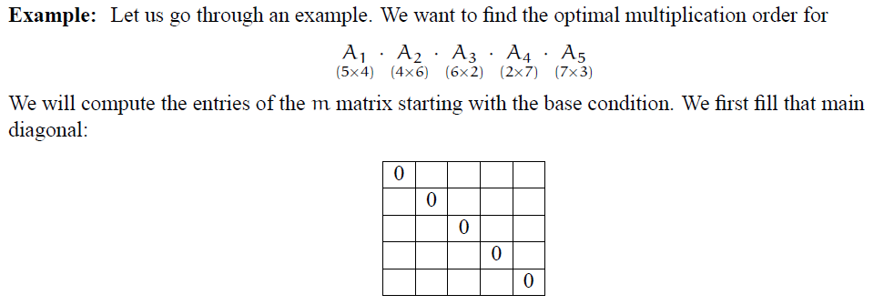
Matrix chain multiplication: Dynamic Programming
Here A = { A1,A2,A3,A4,A5} ; starts from index 1
and P = {5,4,6,2,7,3}; starts from index 0

Slide 24
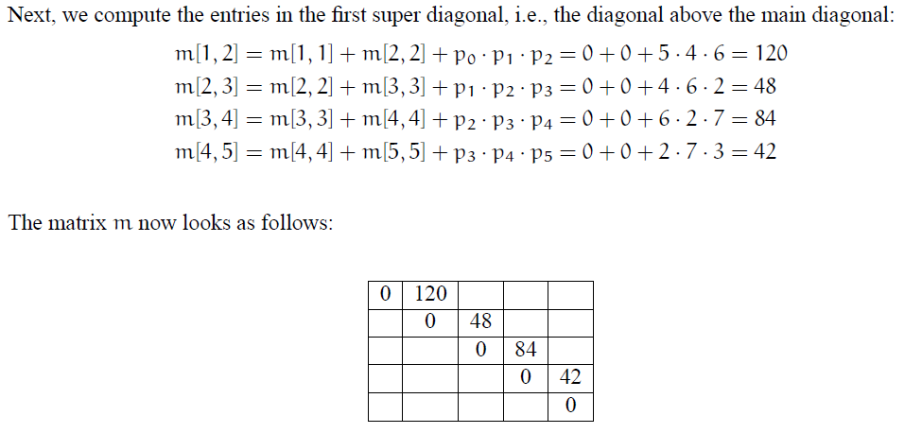
Matrix chain multiplication: Dynamic Programming

Slide 25
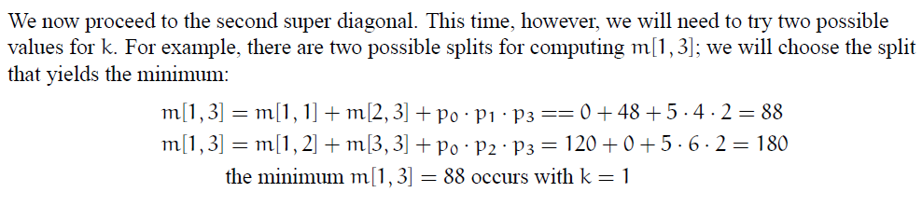
Matrix chain multiplication: Dynamic Programming

Slide 26
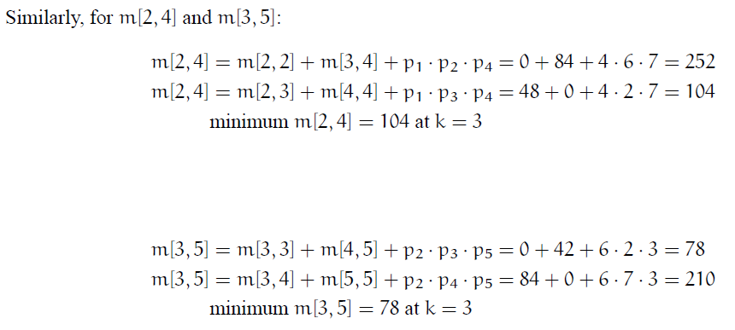
Matrix chain multiplication: Dynamic Programming

Slide 27
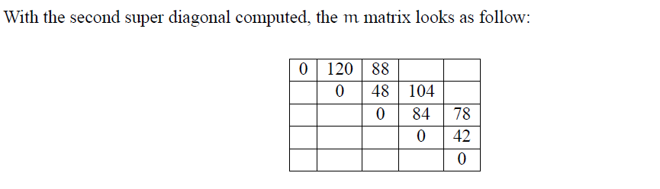
Matrix chain multiplication: Dynamic Programming

Slide 28
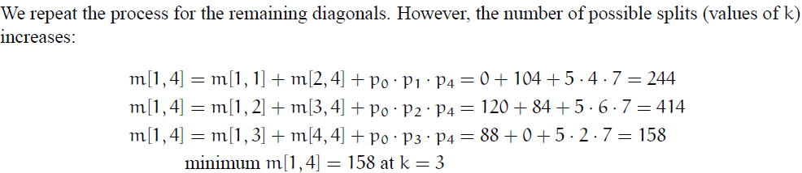
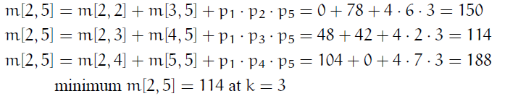
Matrix chain multiplication: Dynamic Programming

Slide 29
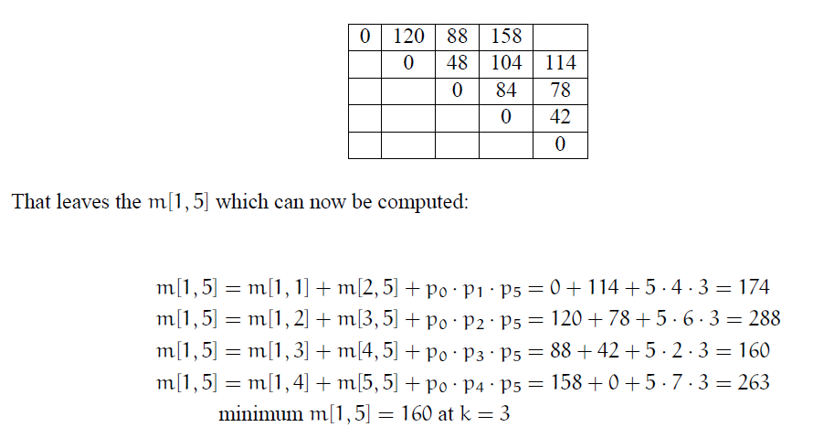
Matrix chain multiplication: Dynamic Programming

Slide 30
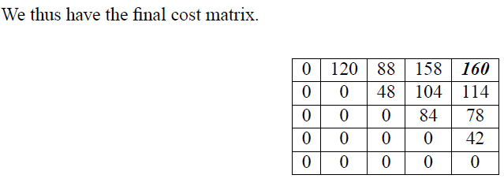
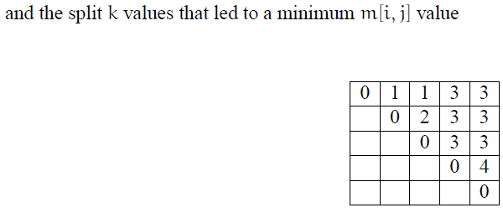
Matrix chain multiplication: Dynamic Programming
Matrix “m”
Matrix “s”

Slide 31
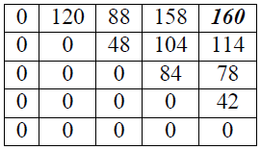
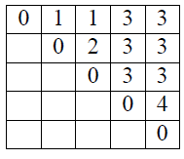
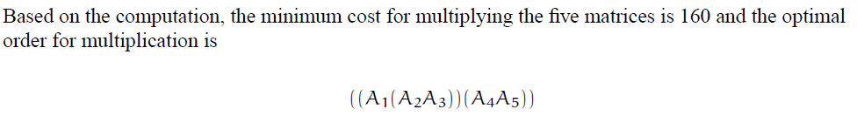
Matrix chain multiplication: Dynamic Programming
Matrix “m” top right value is minimum cost for multiplying five matrices and Matrix ”s” is used to put parenthesis or order in which they will be multiplied to get that minimum cost.

Slide 32
Matrix chain multiplication: Dynamic Programming
How to put parenthesis by “s” matrix :
To find order or parenthesis, start from top right value s[1,5]. At s[1,5], we have k=3 where row value is A1 and column value is A5 so this means that divide A1,A2,A3,A4,A5 into (A1A2A3)(A4A5).
Now it has been divided into two parts. First part is from 1 to 3 and second from 4 to 5. So look for s[1,3] and s[4,5].
At s[1,3], we have k=1 (from below “s” matrix) where row value is A1 and column value is A3 so this means that divide A1,A2,A3 into (A1)(A2A3) so the complete becomes (A1(A2A3))(A4A5)
At s[4,5], we have k=4 where row value is A4 and column value is A5 so this means that divide A4,A5 into (A4)(A5) which wont make any effect so the complete becomes (A1(A2A3))(A4A5)
Matrix “s”

Slide 33
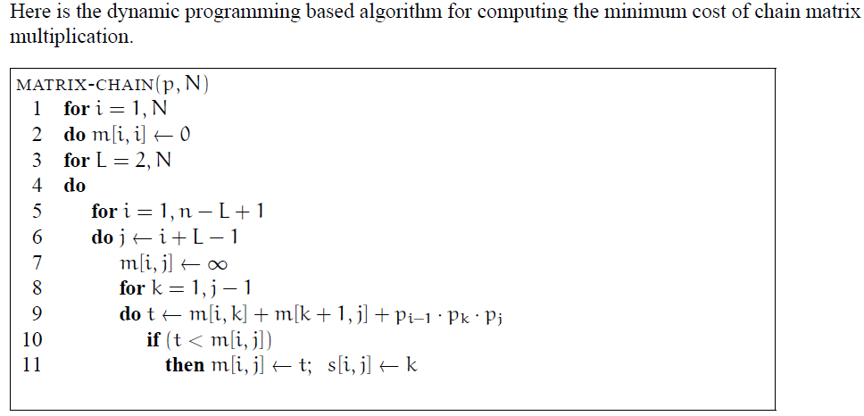
Matrix chain multiplication: Dynamic Programming

